Slide 1
1. Teacher Instructions
Introduction: Wise water users
Length: Approximately 1 x 60-minute lesson + homework task (optional)
Description: Students consider the importance of using water wisely and plan for action
Equipment:
For each group:
One set of water saving cards
One copy of Student worksheet: Using water wisely
Overview:
Students learn about water catchments, the sewerage network, water scarcity and sustainability
Allocate your students into groups
***See Notes on each slide for more teaching notes and ideas***

Slide 2
Instructions
The following is a suggested sequence of activities and time allocation. You might want to spend more or less time on specific sections depending on your class and their learning requirements. All resources can be edited to suit your teaching needs.
Slide | Description | Time
1.1: Introduction | Discuss: Why is it important to use water wisely | 10 mins
1.2: Alternate water supply | Explain the different types of alternate water: Desalination, Recycled water and Stormwater harvesting | 10 minutes
1.3: Water saving | Instructions on how to conduct the activity. | 30 minutes
1.4: Things to think about | Students complete the worksheet | 10 minutes
Optional | Students take their plan home and discuss it with their family

Slide 3
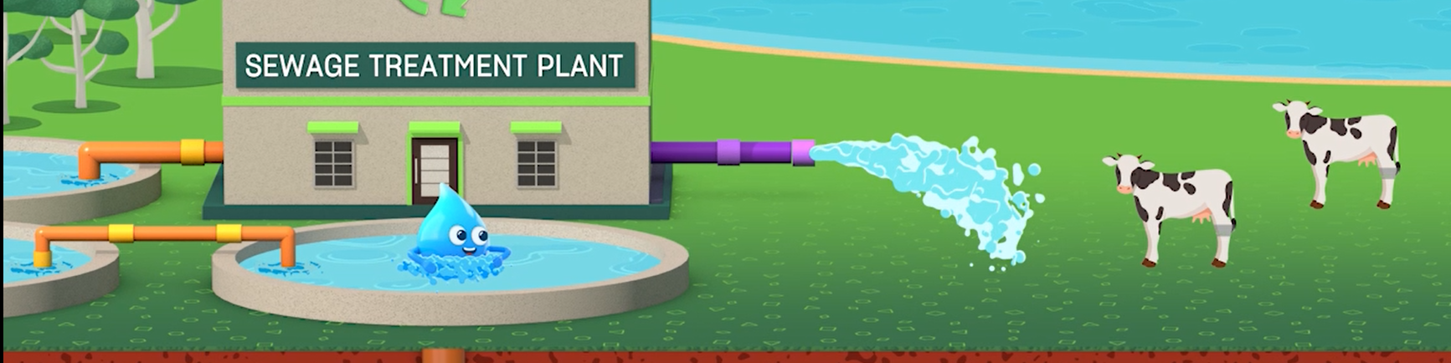
Water wise users

Slide 4

Learning outcomes
Understand the different uses of water and that wastewater can be recycled
Identify where tap water comes from and know what happens when it goes down the drain
Identify the importance of water to sustaining the lives of people

Slide 5
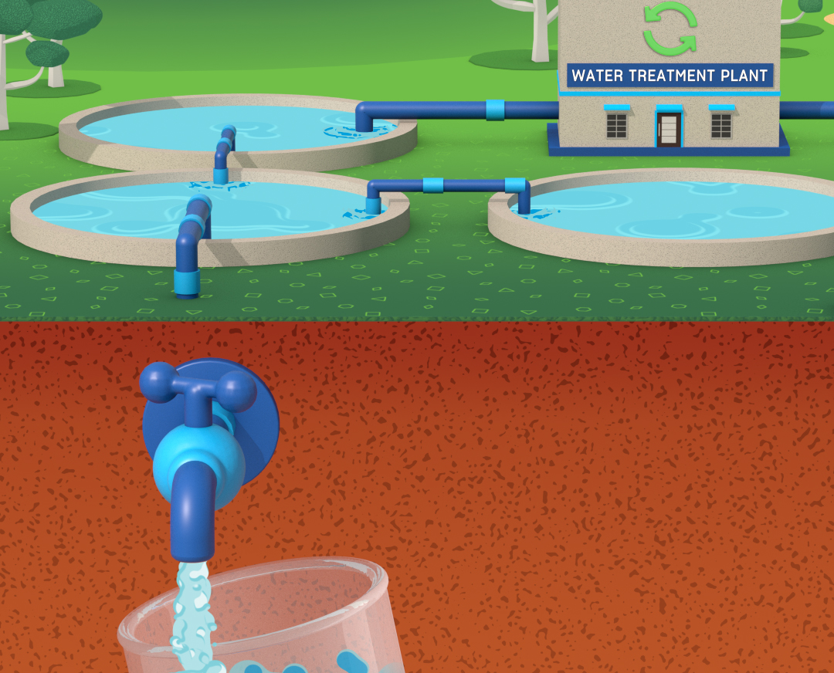
1.1 Introduction
Think about the importance of using water wisely and plan for action
Notes:
Teaching notes and ideas
Recap with students about where their water comes from, plus the differences between the urban and natural water cycles.
Explain that in this lesson they will learn more about how we plan for action and what is already being planned.
Discuss with students about why it is important to use water wisely for the environment and for our future.

Slide 6
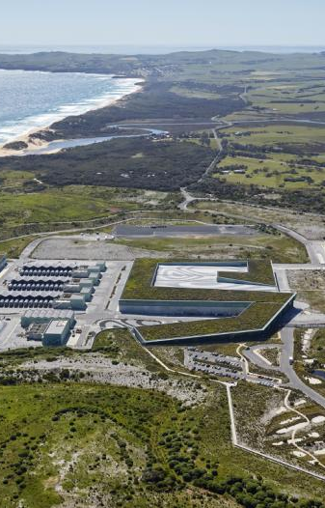
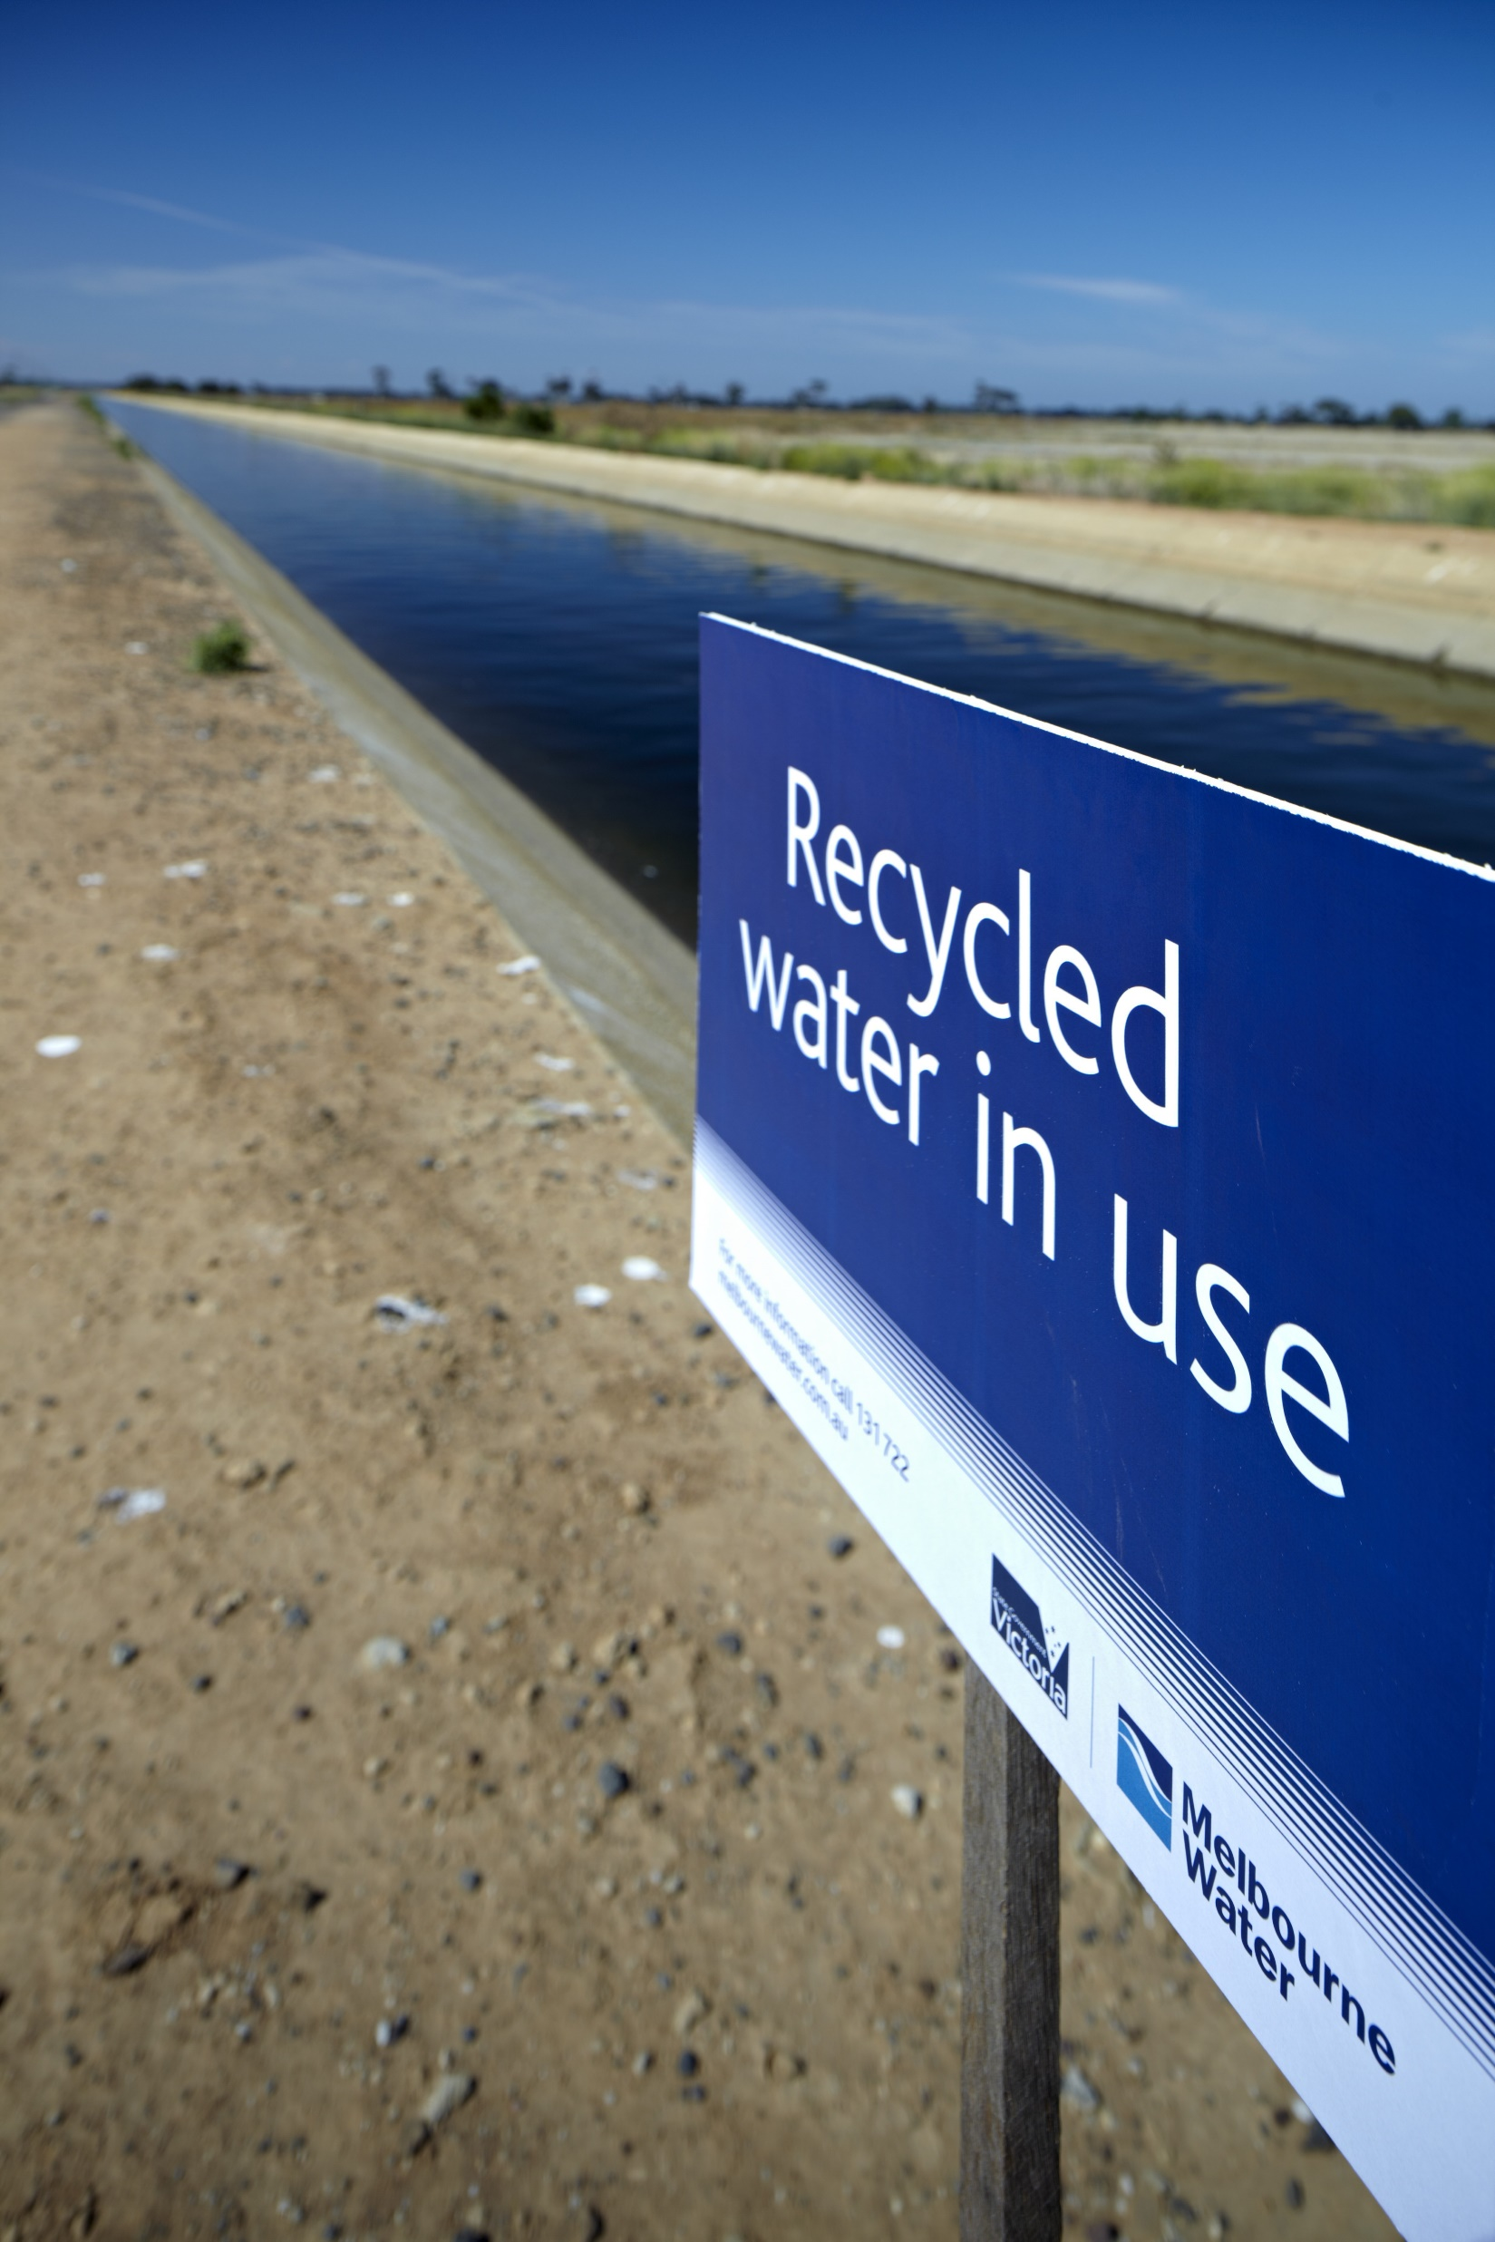
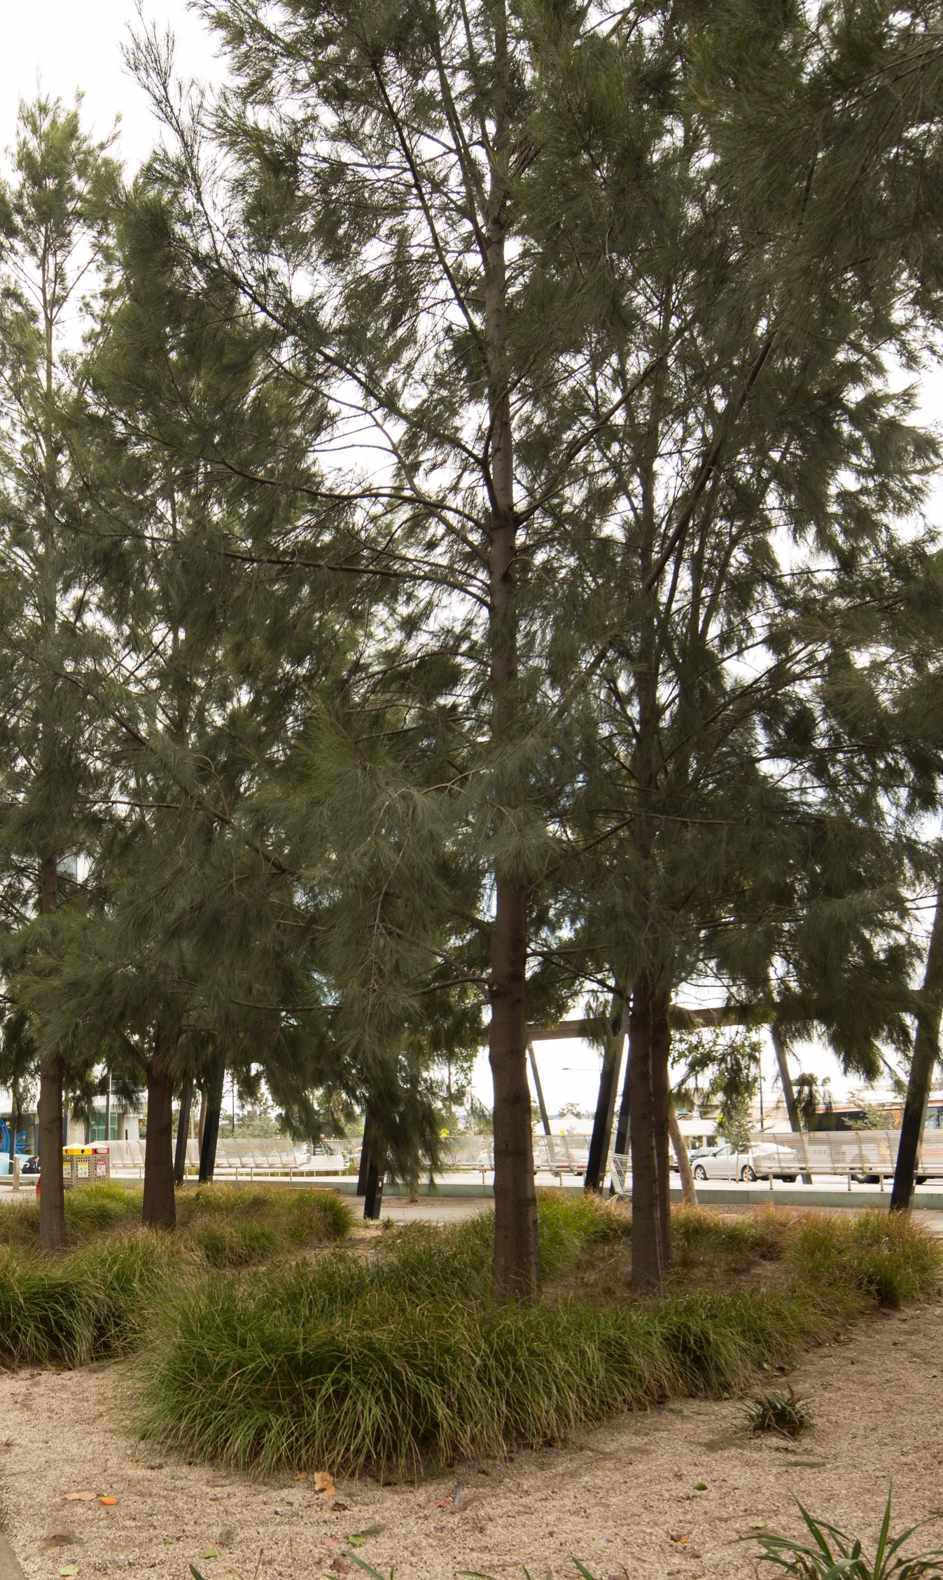
1.2: Alternate water sources
Recycled water
Stormwater harvesting
Desalination
Notes:
Teaching notes and ideas
1. Explain how water is reused to save high quality water for its special uses.
2. Talk about other sources of water such as recycled water and stormwater harvesting, what the recycled water is used for and how the water is returned to the natural water cycle after its time in the urban water cycle.
3. Click on each image for more information. Note, you will be taken to the World of Water
4. You can ask students to write down a brief explanation of each type of alternate water and how each is reused.

Slide 7
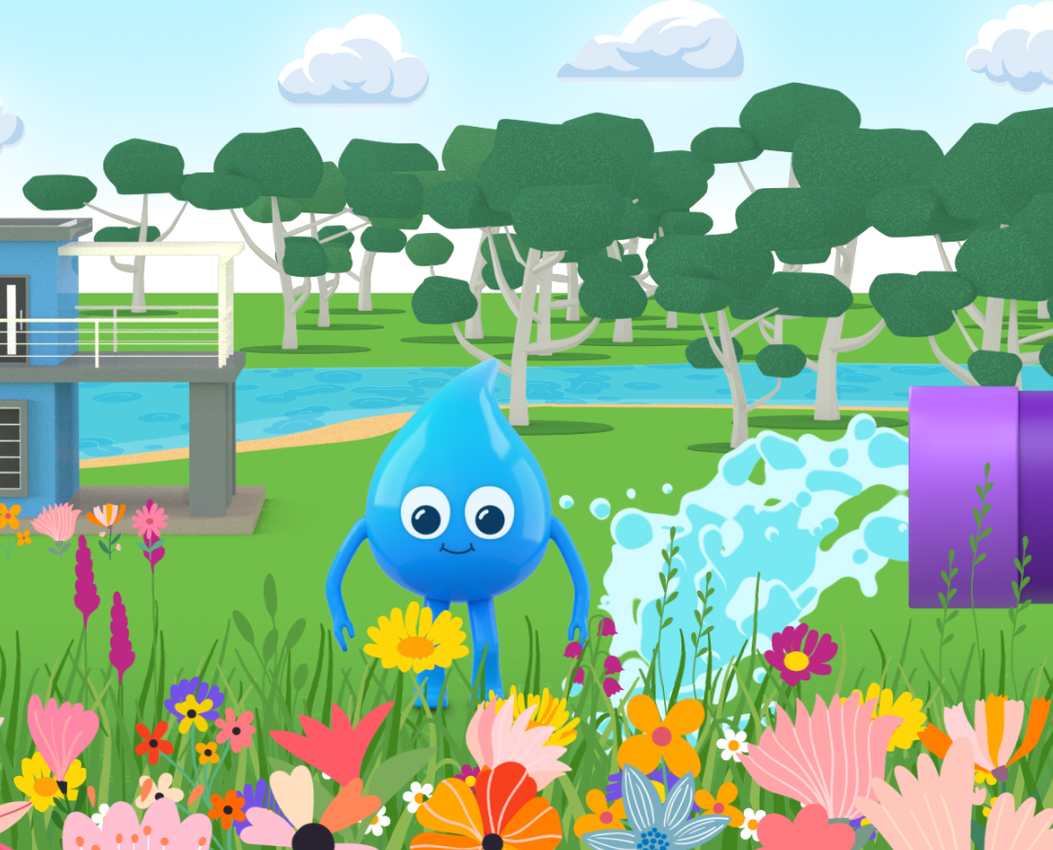
1.3 Water saving
Take four cards
Take turns to present your cards to the group and explain why you think it is important for the environment or our future.
Sort the cards into different collections
- water saving ideas for the environment
- water saving ideas for our future
- water saving ideas for the environment and for our future
Notes:
Teaching notes and ideas
Print up and cut out the water saving cards – see the downloads
Put students into groups of three or four students
Organise the water saving cards so that there is one set among each group
Explain that each group will receive a set of water saving cards
Each student randomly takes four cards from the set and has time to consider why the water saving idea is important for the environment, our future or both.
Note: It is recommended that one card is presented at a time, and students rotate taking turns until all the cards have been presented.
Groups sort the cards into different collections—water saving ideas for the environment, for our future or for both. Groups can share their ideas with the class.

Slide 8
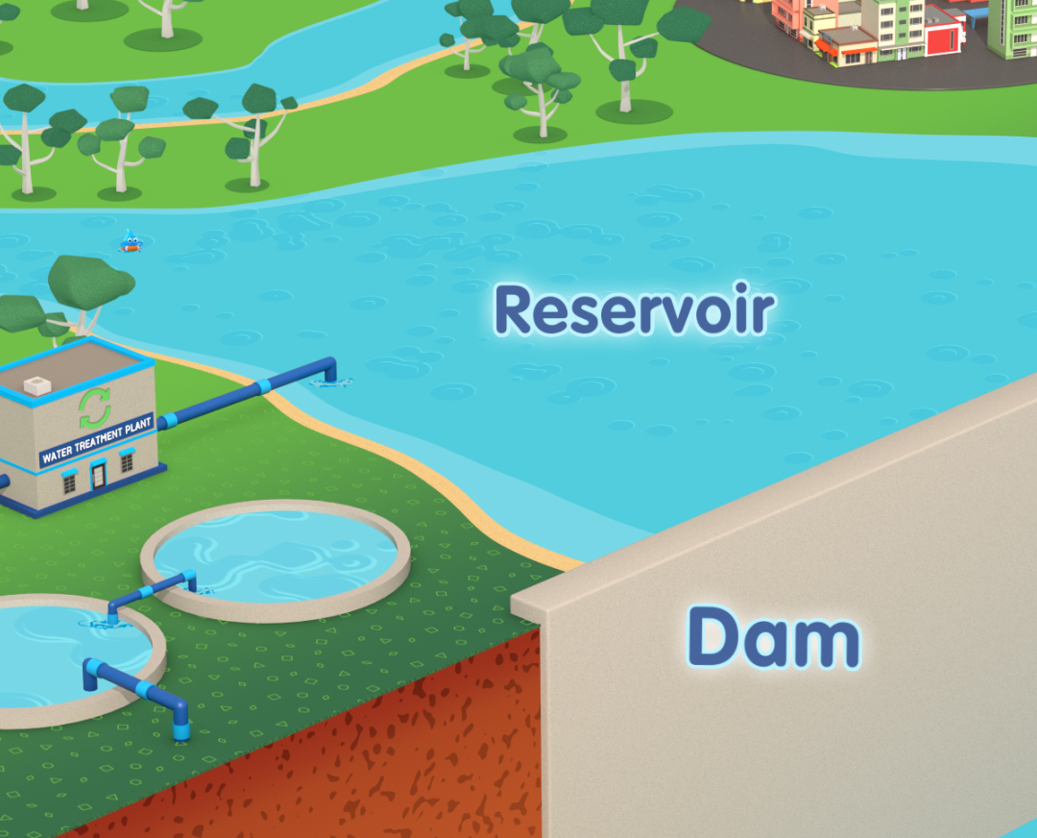
1.4 Thinks to think about
the water cycle and how this idea links to it, for example, mulch reduces evaporation and keeps moisture in the ground
rivers and creeks which flow to reservoirs and to the sea
animal and plant life in their waterway environment
reservoirs which store our drinking water
recycled water: for example, treated water for use in parklands, golf courses and farms; water from the laundry and shower for use in the garden.
Notes:
Teaching notes and ideas
Encourage students to think about: the dot points in the slide
Distribute the Student worksheet: Using water wisely and explain that they will use the ideas from the water saving cards discussion to complete it. Students refer to the water saving cards for ideas and prompts, recording:
- reasons of using water wisely for the environment and our future
- their favourite water saving ideas from the water saving cards
Students choose a favourite idea to develop into a plan that they think their family could do.
Students take their plan home and discuss it with their family

Slide 9
Curriculum links
Science: VC2S4U07, VC2S4U08
Geography: VC2HG4K01,VC2HG4K09

